Slide 1


Rainfall Prediction
Team Members :
Sujitha R
ShanthaReddy
Tejesh Bathula
Santhosh Sriram
Kumar Suraj
Mentor :
Vikash Chandra

Slide 2
PROBLEM DEFINITION
The fact that Rainfall nowadays is not happening seasonally, there are many reasons such as Deforestation, Industrial revolutions, Urbanization or Modernization, hazardous gases from vehicles and many more.
Rainstorm is one of the major issues that should be concentrated as it is highly related with landslides, earthquakes and many more. Having an appropriate approach for rain fall prediction makes it possible to take preventive measures.
The shortage of rain will cause immense problems for agricultural activities, power generation, variation in climate leads to global warming. Also, increase in rainfall cause landslides, floods, damaging infrastructure and many more.

Slide 3
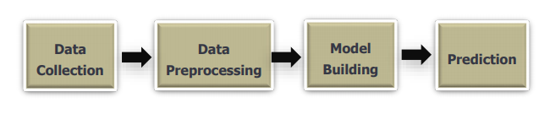
TECHNIQUES TO TREAT THE PROBLEM
Usage of older techniques such as Persistence, usage of barometer, looking the sky, nowcasting won’t help now to predict the rainfall effectively.
The Objective or Solution is to Predict the occurrences of rainfall in future using analytical or Machine learning techniques using various Machine Learning models, with the help of features such as rainfall, sunshine, pressure, temperature, wind speed and other Independent features.

Slide 4
ANALYSIS OF DATASET
DATA SET CONSIDERED
For our Project Rain Fall Prediction we have the Dataset ‘WeatherAUS.CSV’.
We have a total of 23 Columns and 1.45 lakh Records or Rows.
There are 16 Numerical and 7 Categorical Columns in the Dataset.
We have used this Dataset for both EDA and ML Modelling process.

Slide 5
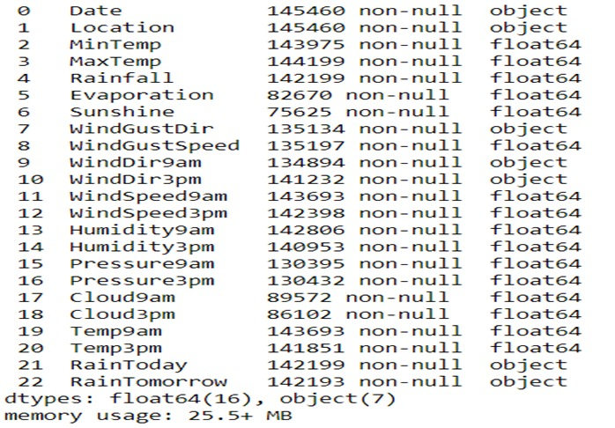
DATA DESCRIPTION
We have a total of 16 numerical features and 7 categorical features in our dataset.
The percentage of numerical features is around 70% and that of categorical features is around 30%.

Slide 6
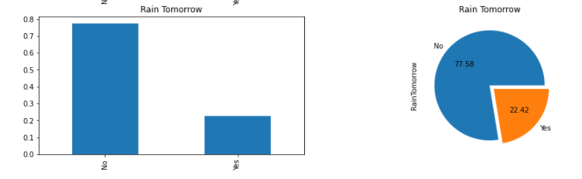
VISUALIZATION OF TARGET VARIABLE
Class Imbalance can be Observed in the Target Variable ,which can be treated in our further analysis.

Slide 7
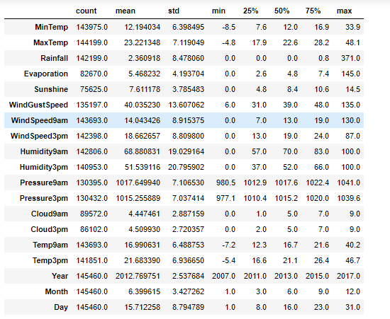
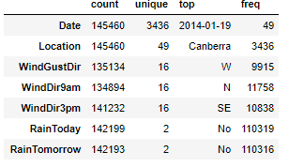
Data Describe
Numerical Describe
Categorical Describe

Slide 8
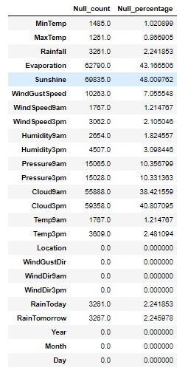
NULL VALUE AND OUTLIER TREATMENT
Null values are imputed using Iterative imputer method.
Rows are removed if target column have null values in it.
We have observed that our data has nearly 40% of outliers with the help of box plot.
Hence, instead of removing the outliers which would result in data loss we apply power transform on our data which makes the data more normal.

Slide 9


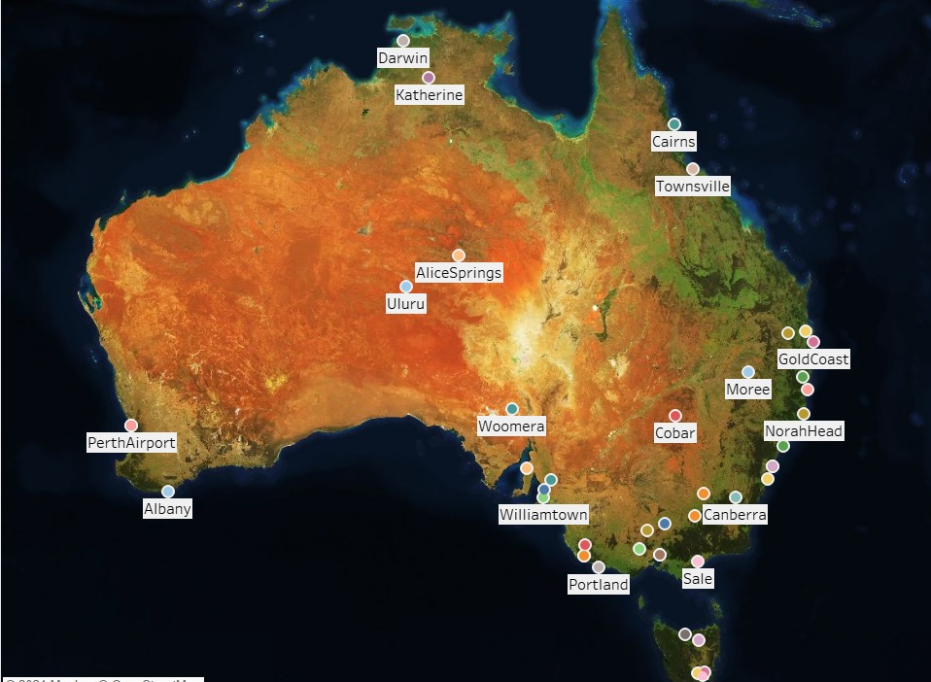
VISUALIZATION OF CITIES

Slide 10
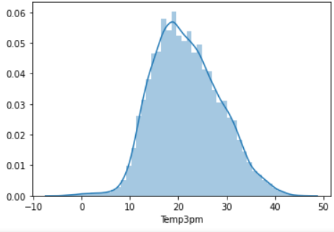

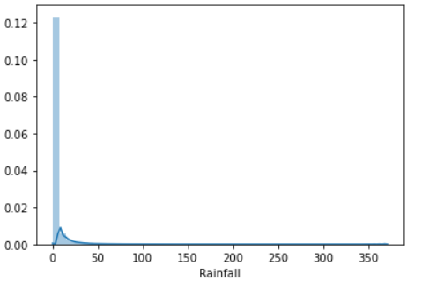
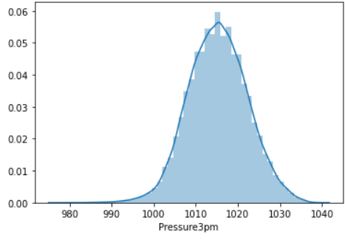
DATA ANALYSIS
From the distribution plots, we can infer that the features Temp3pm, Temp9am and Pressure 3pm are normally distributed and the feature Rainfall is not normally distributed and it is right skewed.
Also there are some features in our dataset which are not normally distributed and have been treated using Power Transformer.

Slide 11
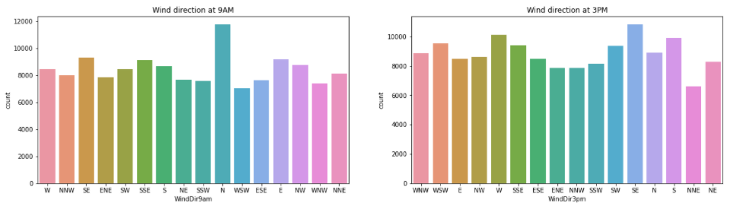
DATA ANALYSIS
From the above count plot we infer that :
At 9AM the wind is more at North direction.
At 3PM the wind is more at SouthEast direction.

Slide 12
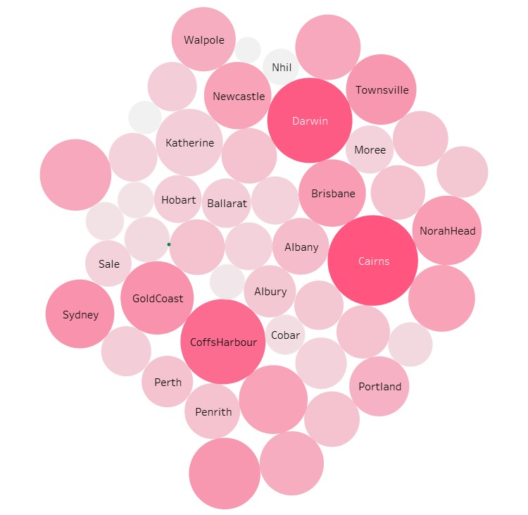
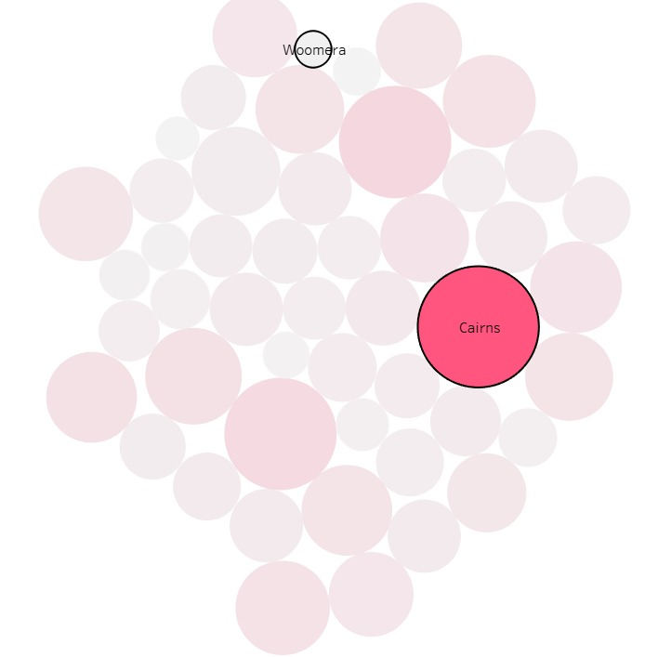
AVERAGE RAINFALL AT DIFFERENT LOCATIONS
From the above visualizations we can infer that maximum rainfall is at Cairns and minimum rainfall is at Woomera.

Slide 13
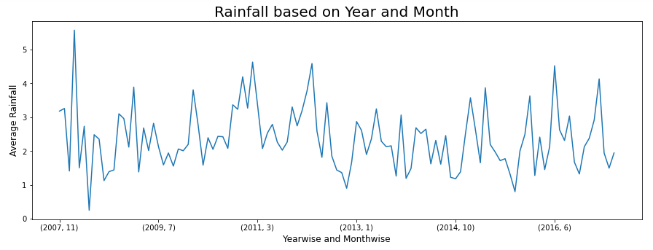
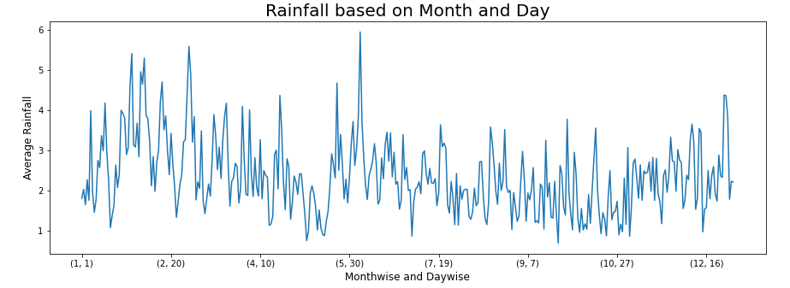
We are comparing data of past 10 years. From the line plot of Rainfall based on Year and Month, we infer that Both maximum and minimum average rainfall is observed in 2008 for the months of Feb and April.
We are comparing data of past 10 years. From the line plot of Rainfall based on Month and Day, we infer that the average rainfall is more in the month of June and less in the month of September.

Slide 14
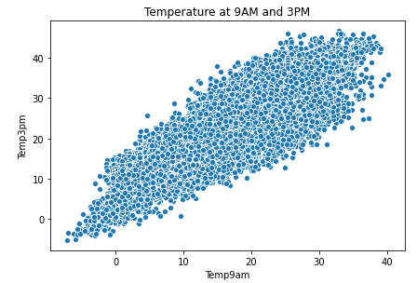
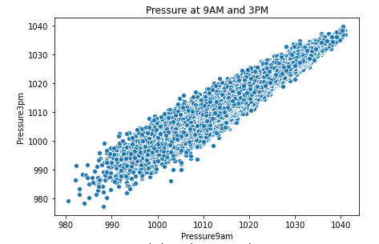
From the above scatter plot, we infer that there is linear relationship between Temp9am and Temp3pm. As the Temp9am increases the Temp3pm also increases.
As we know that, if there is increase in Temperature the chances of rainfall is less.
From the above scatter plot, we infer that there is linear relationship between Pressure9am and Pressure3pm. As the Pressure9am increases Pressure3pm also increases.
As we know that, if there is increase in Pressure the chances of rainfall is less.

Slide 15
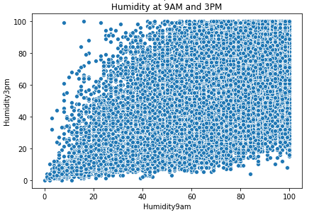
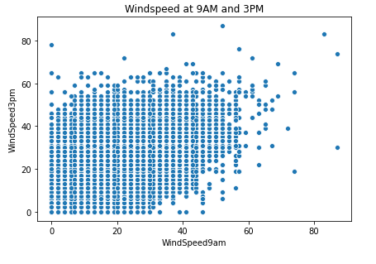
From the above scatter plots, we can infer that no linear relationship can be observed for both Windspeed and Humidity at different time spans.

Slide 16
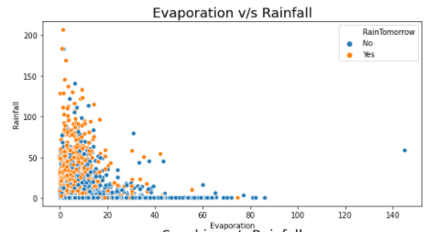
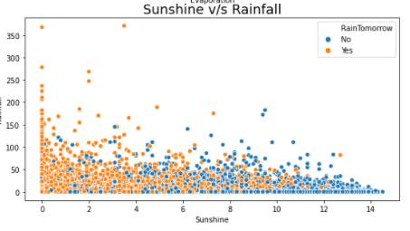
ANALYSIS
From the scatter plot between Evaporation and Rainfall, we infer that if the evaporation is less there is more chances of rainfall in that day.
From the scatter plot between Sunshine and Rainfall, we infer that as the Sunshine increases there is chances of a rainfall but rainfall rate is less.

Slide 17
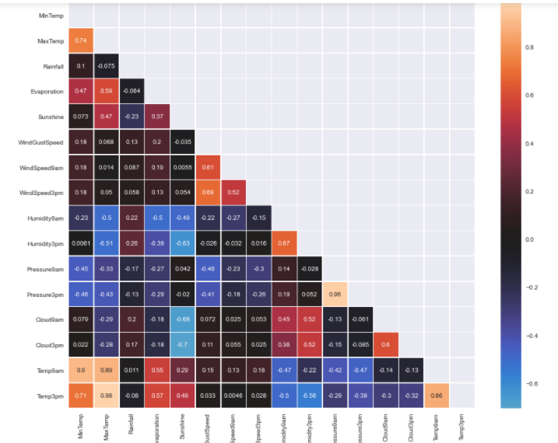
CORRELATION – HEAT MAP
Few pairs of variables shows strong correlation between them they are, MinTemp and MaxTemp (r=0.74) * WindSpeed3pm and WindGustSpeed (r=0.69) * Temp9am and MinTemp (r=0.90) * Pressure3pm and Pressure9am (r=0.96) * Temp9am and MaxTemp (r=0.89) * Temp3pm and MinTemp (r=0.71) * Temp3pm and MaxTemp (r=0.98). We can also observe that there is presence of multicollinearity between various features.

Slide 18
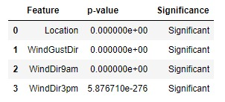
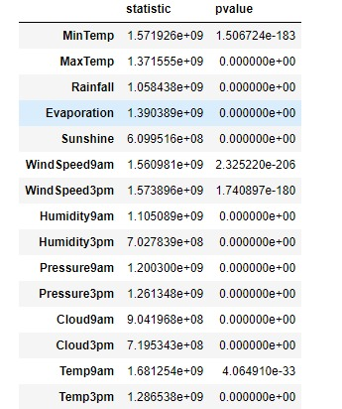
STATISTICAL ANALYSIS OF FEATURES
The statistical significance of various categorical features with the target variable can be determined by using Chi-Square Test. From the results, we can infer that the features Location,WindGustDir,WindDir9Am and WindDir3Pm are significant.
For checking the statistical significance of numerical features with the target variable, we performed the Shapiro test of normality and we observed that data is not normally distributed hence we performed Manwhitneyu test (Non-Parametric) and found out that all the numerical features are significant.

Slide 19
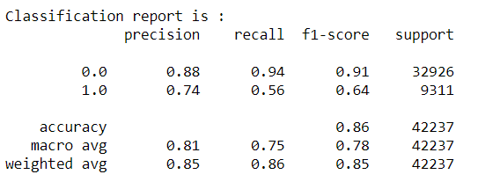
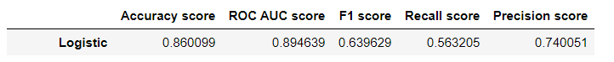
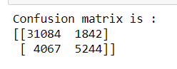
BASE MODEL BUILDING
We have Considered Logistic Regression as our Base Model.
Accuracy score for our base model is 86%.
Here we can observe that our base model is not able to predict around 5910 observations correctly.
Also, the recall score for class 1 is very low and hence our base model is poorly performing in predicting
rainfall.

Slide 20
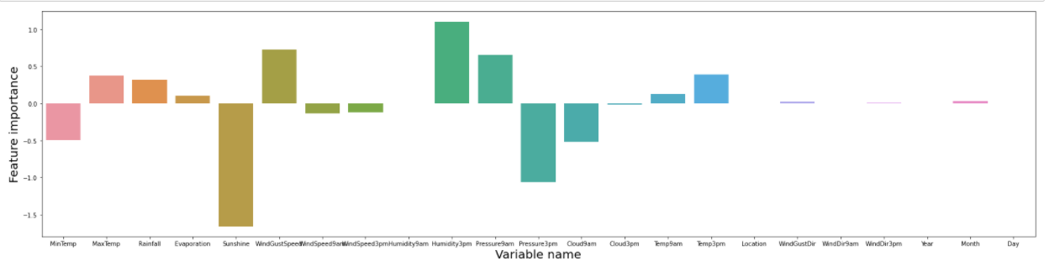
FEATURE IMPORTANCE
From the above bar plot we infer that :
Humidity 3pm is the most important feature for rainfall prediction (1.1040).
Variables such as Sunshine, Pressure3pm, Cloud9am, MinTemp shows strong negative correlation with the target variable.
Variables such as Rainfall, MaxTemp, Pressure9am, WindGustSpeed and Humidity3pm shows strong positive correlation with target variable.

Slide 21
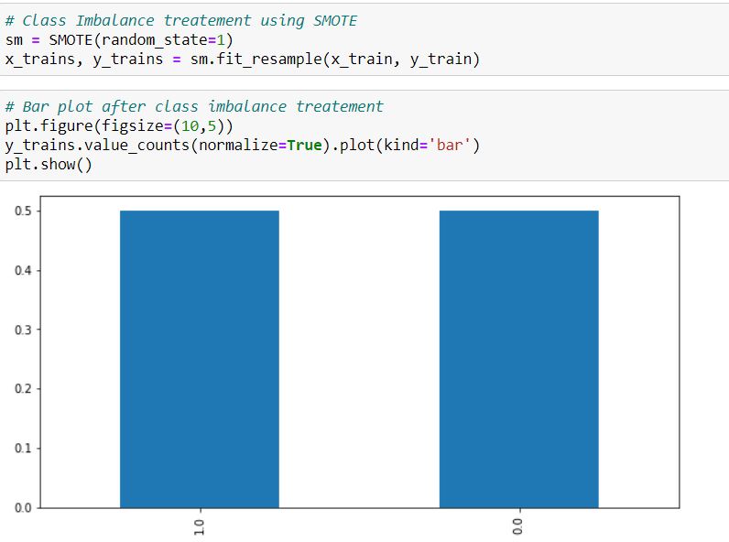
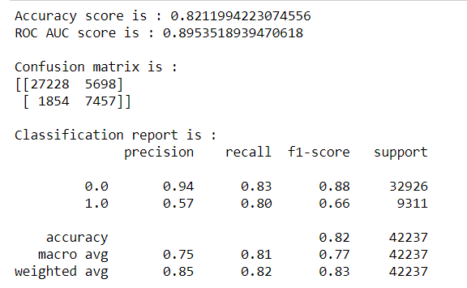
CLASS IMBALANCE TREATMENT BY SMOTE
After Treating the Imbalance data,
Overall accuracy of the model is decreased from 85.99% to 82.10%
Recall score is increased from 56% to 80%. So able to predict rain in better way compared to base model.
Precision score is dropped from 74% to 57%, so the chances of predicting non rainy days as rainy is more.
There is significant increase in F1 score is observed from 64% to 66%.

Slide 22
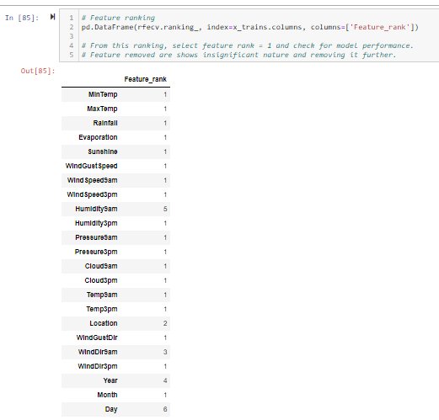
Recursive Feature Engineering
We did RFE method for Feature Selection process.
Variables selected with RFE technique are :
[‘Min Temp', ‘Max Temp’, 'Rainfall', 'Evaporation', 'Sunshine', 'WindGustSpeed', 'WindSpeed9am', 'WindSpeed3pm', 'Humidity3pm', 'Pressure9am', 'Pressure3pm', 'Cloud9am', 'Cloud3pm', 'Temp9am', 'Temp3pm', 'WindGustDir', 'WindDir3pm', 'Month’]
We can use these best features for our further model analysis.

Slide 23
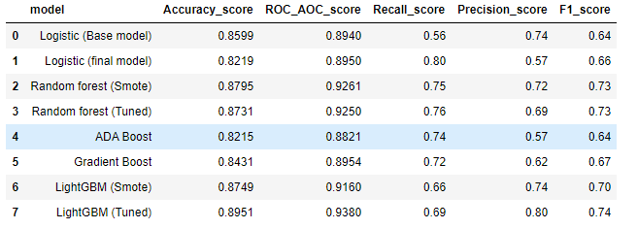
MODEL COMPARISON
From above models, LightGBM(Tuned) is giving good model accuracy as well as ROC AUC score.
Also, the Precision score and F1 score obtained is good for LightGBM(Tuned) model.
From the above dataframe we are selecting LightGBM(Tuned) as the best method for predicting whether tomorrow
is the rainy day or not.

Slide 24
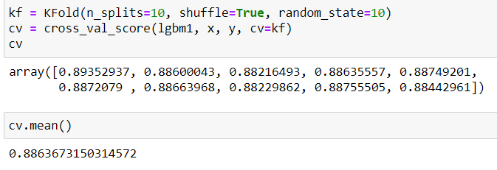
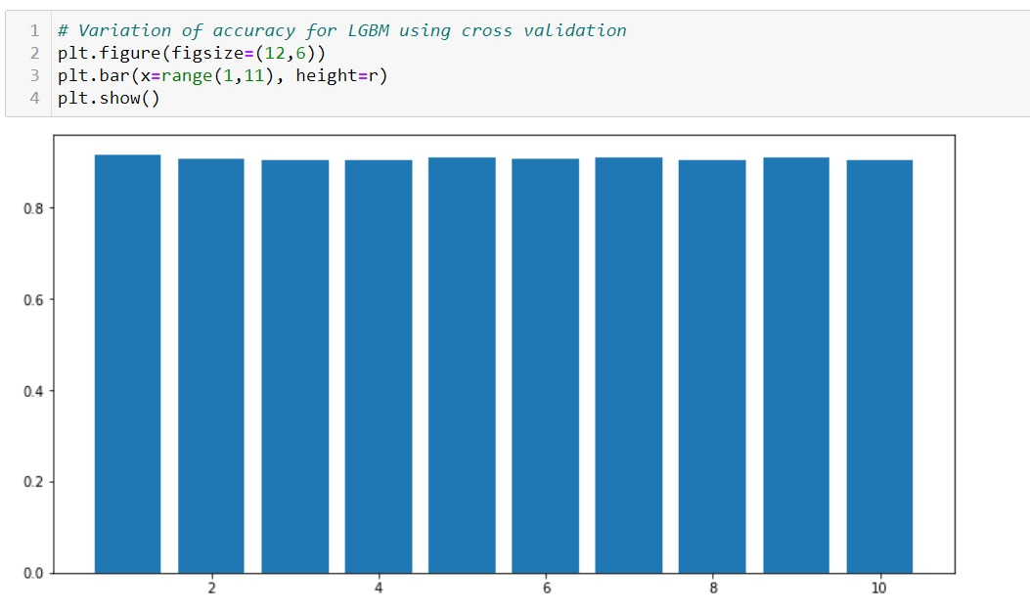
MODEL STABILITY USING KFOLD
We have checked the stability of our final model (LGBM) with K-Fold cross validation with n_splits = 10.
From the bar plot, we can infer that for each split, accuracy of around 90% is achieved which matches with our LGBM (Tuned) model accuracy. Hence we consider this model to be most stable.

Slide 25
CONCLUSION
This model after deployment can further be used to predict the rainfall on different locations based on business applications.
Currently machine learning is used in many industries. As the data increases, the complexity of that data will increase and for that we are using machine learning models for the better understanding of that data.
In Weather predictions it’s pretty helpful with good accuracy score,f1_score in rainfall also its gives pretty good predictions.
In future we are planning to increase our work in Storm predictions and Crop prediction with the rainfall prediction.

Slide 26
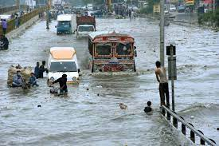
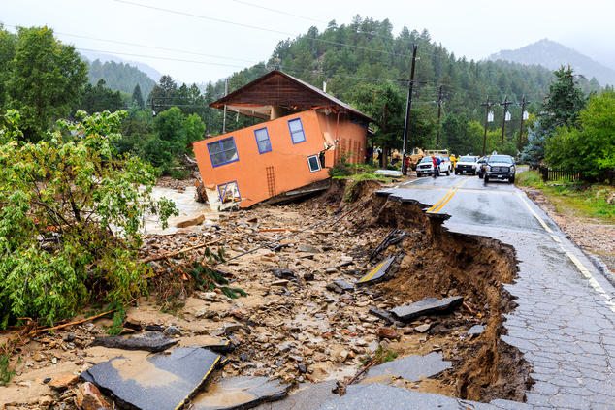
Business Problems
Rainfall is useful for agriculture but heavy rains causes damage of crops.
Flooding, including risk to human life, damage to buildings and infrastructure.
Landslides, which can threaten human life, disrupt transport and communications.
Too much precipitation can also have a negative impact on human activities, business and industry, agriculture, and the environment.

Slide 27

THANK YOU!!!
THANK YOU!!!

